Slide 1

CIT-2180 Data and Database Management Chapter 2

Slide 2

Oracle 12c: SQL
Chapter 2
Basic SQL SELECT Statements

Slide 3
Create the JustLee Database
Use the provided script to create the database so you can follow the chapter examples
Verify table contents using the DESCRIBE command
3

Slide 4
SELECT Statement Syntax
SELECT statements are used to retrieve data from the database
A SELECT statement is referred to as a query
Syntax gives the basic structure, or rules, for a command
Optional clauses and keywords are shown in brackets
4

Slide 5
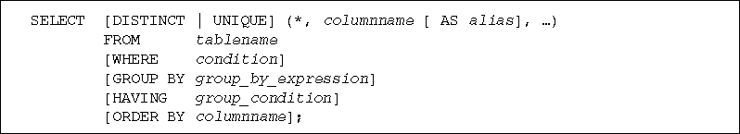
SELECT Statement Syntax (continued)
5

Slide 6
SELECT Statement Syntax (continued)
SELECT and FROM clauses are required
SELECT clause identifies column(s)
FROM clause identifies table(s)
Each clause begins with a keyword
6

Slide 7
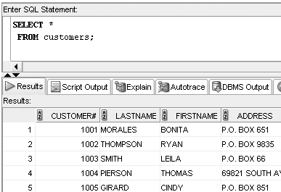
Selecting All Data in a Table
SELECT * FROM tablename;
7

Slide 8
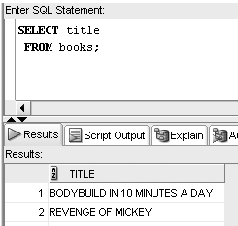
Selecting One Column from a Table
SELECT columnname FROM tablename;
8

Slide 9
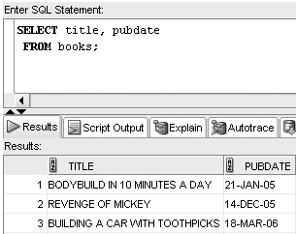
Selecting Multiple Columns from a Table
SELECT col1, col2, coln FROM tablename;
9

Slide 10
Operations within the SELECT Statement
Column alias can be used for column headings
Perform arithmetic operations
Suppress duplicates
Concatenate data
10

Slide 11
Using Column Aliases
List the alias after the column heading
AS keyword is optional
Enclose in double quotation marks:
If it contains blank space(s)
If it contains special symbol(s)
To retain case
11

Slide 12
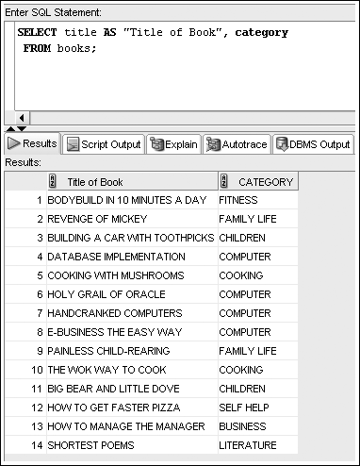
Column Alias Example
12

Slide 13
Using Arithmetic Operations
Arithmetic operations
Executed left to right
Multiplication and division are solved first
Addition and subtraction are solved last
Override order with parentheses
Very similar to the rules of calculations in Excel
13

Slide 14
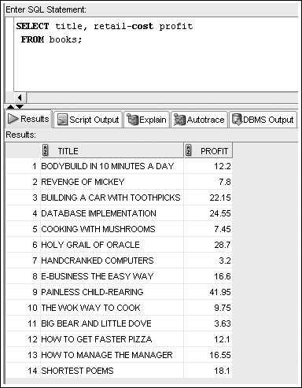
Arithmetic Operation with Alias Example
14

Slide 15
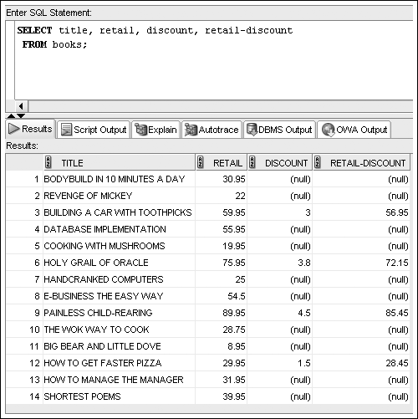
NULL Values Example
15

Slide 16
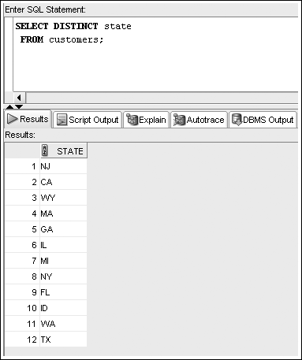
DISTINCT and UNIQUE Example
16

Slide 17
Using Concatenation
You can combine data with a string literal
Use the concatenation operator, ||
It allows the use of column aliases
17

Slide 18
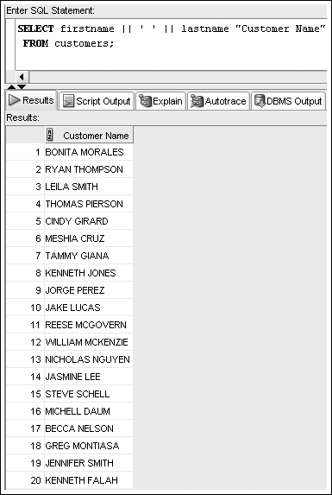
Concatenation Example
18

Slide 19
SELECT Statement Syntax (revisited)
19

Slide 20
Oracle 12c: SQL
END OF Chapter 2
Basic SQL SELECT Statements

